Slide 1
SPSS Notes

Slide 2
SPSS Overview
Open SPSS
First screen will let you open data or close to type in data.

Slide 3
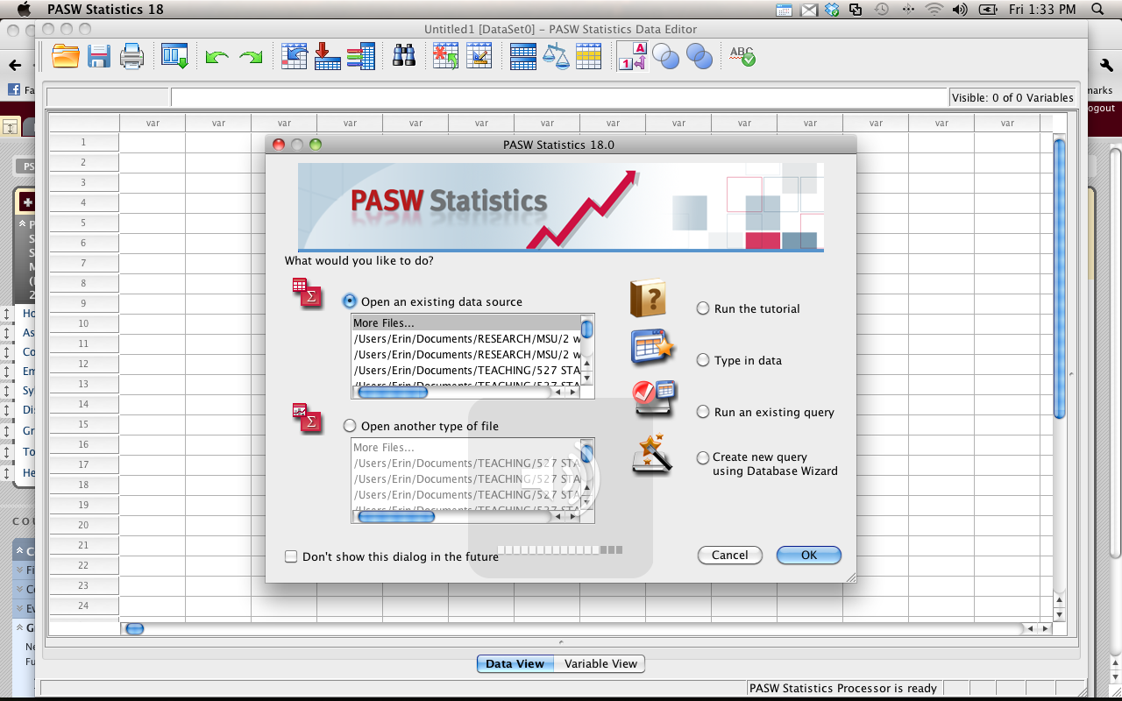

Slide 4
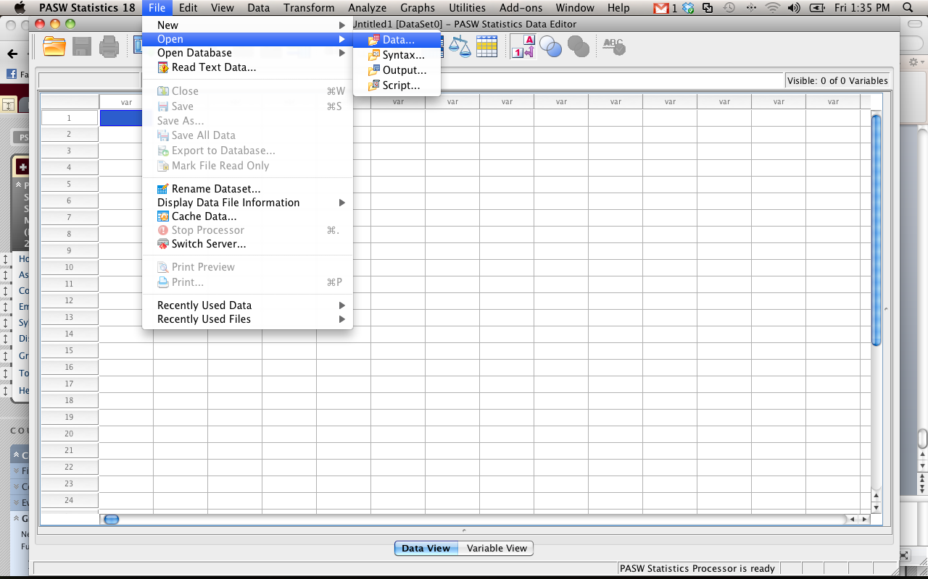

Slide 5
Opening Files
Open behavior.sav
.sav files are data files.
.sps files are syntax files.
.spv are output files.

Slide 6
File Set up
Data view
Columns = variables
Rows = people
Behavior example
Gives you the place for a behavior (column 1)
And then the ratings for each type of behavior (going across).

Slide 7
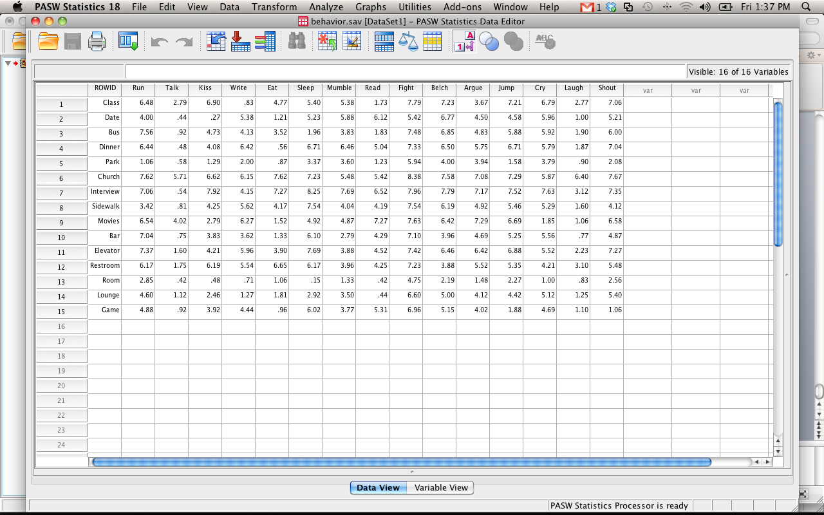

Slide 8
File Set Up
Variable view
Has the list of variables (one for each row)
These will be the columns across the top
Type column
If you want to put letters into a column, be sure the type column is “string” or it won’t work.
Also! If you label a column as string and then try to use it in analyses, it will tell you politely that you are dumb.

Slide 9
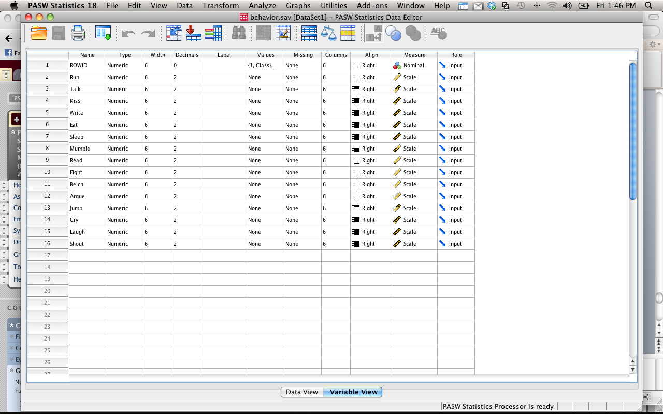

Slide 10
File Set Up
Values column
Click on the little box next to values for the rowid variable.
Now you’ll see a bunch of numbers with corresponding strings
This is a way to label your groups
Try it.

Slide 11
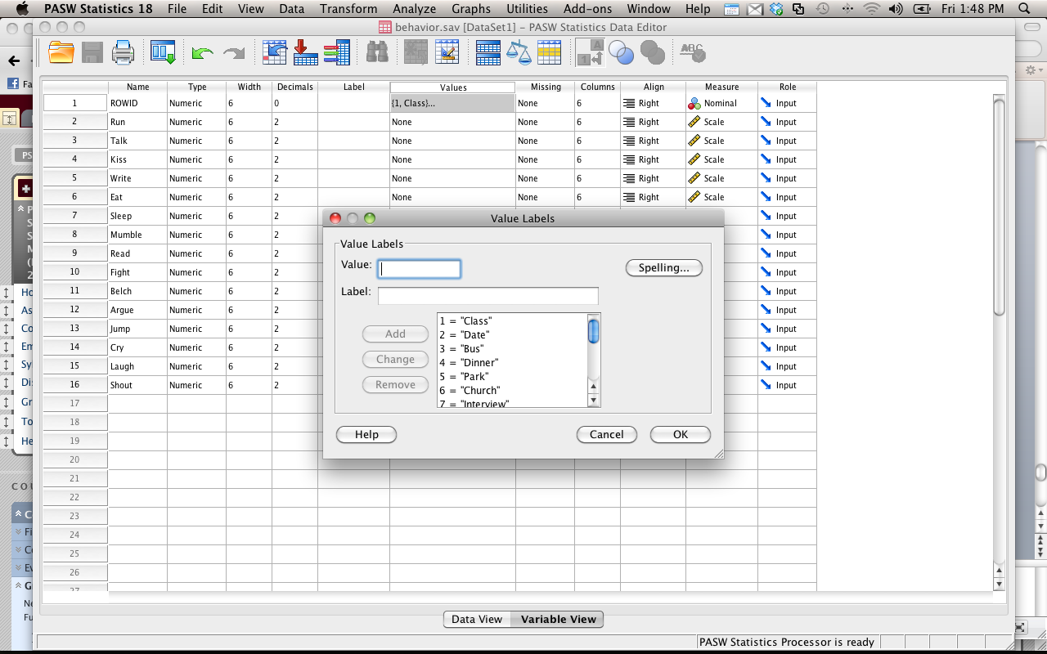

Slide 12
View values
If you can’t see the values you’ve given something when looking at data view
View > value labels

Slide 13
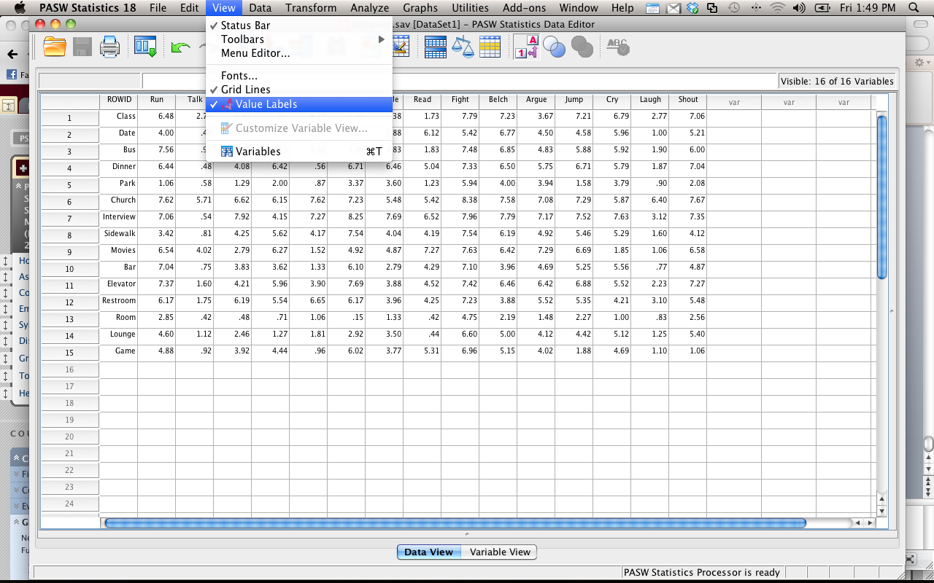

Slide 14
Adding values
If you want a new variable, you can just start typing in a new column.
It will label the variable for you as “var0001” or something similar.
If you want to give it a name, click variable view, and you can relabel it.

Slide 15
Adding values
If you want to add new people
Just start typing in data in a new row.
Note: if you have a column with value labels, then you’ll need to stick with the same numbering system
If you give it a number it doesn’t recognize, it’ll show up as that number.

Slide 16
Data Window
The data option lets you find data you need quickly, or sort cases
We are going to use sort cases
Split file – let’s you run an analysis separate for each group (helpful for data screening).
Select cases – let’s you pick only a subset of the data

Slide 17
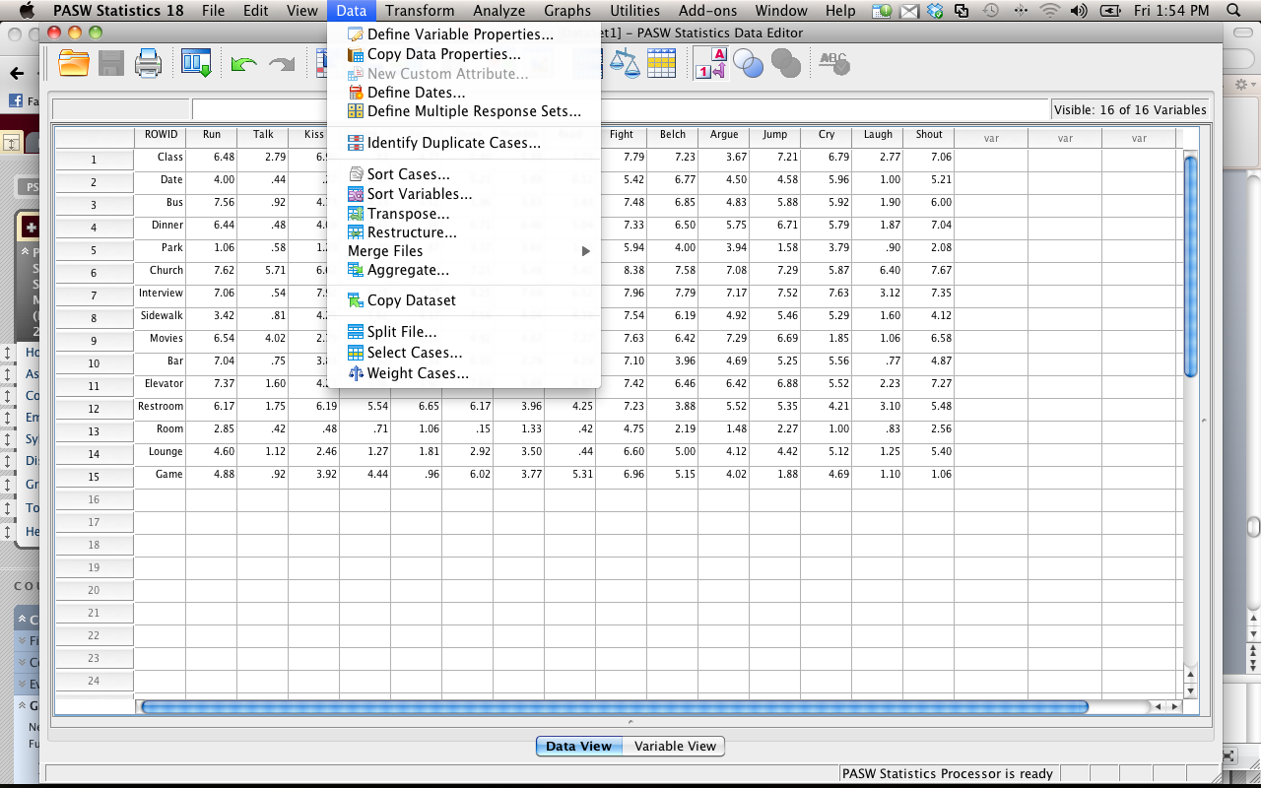

Slide 18
Transform Window
Transform lets you change variables without having to start over
You can create new variables that are functions of old variables (i.e. average two columns, add up four columns, create an interaction term).
Most commonly we are going to use compute variable.
Show random variables!

Slide 19
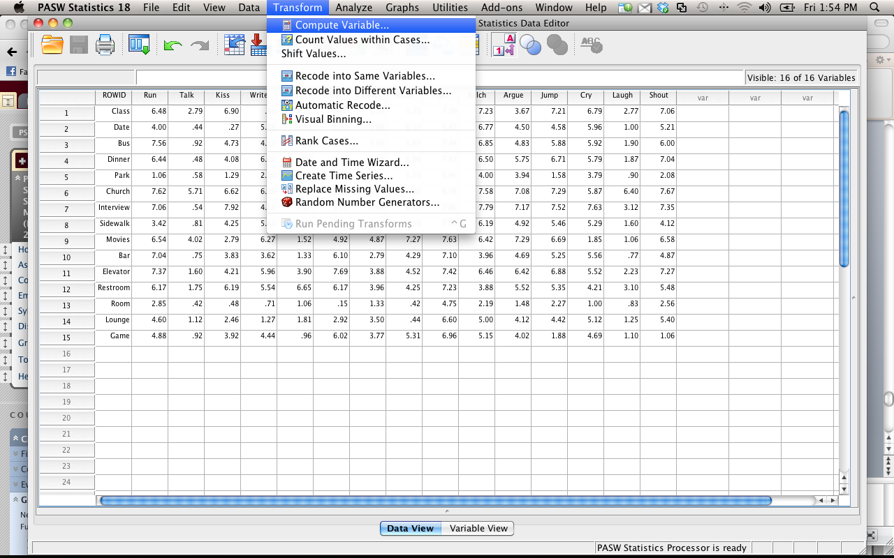

Slide 20
Analyze Window
Most common options we will use
(go through how to run each test when we cover that test).
If you are running a statistical test, it will be under Analyze.

Slide 21
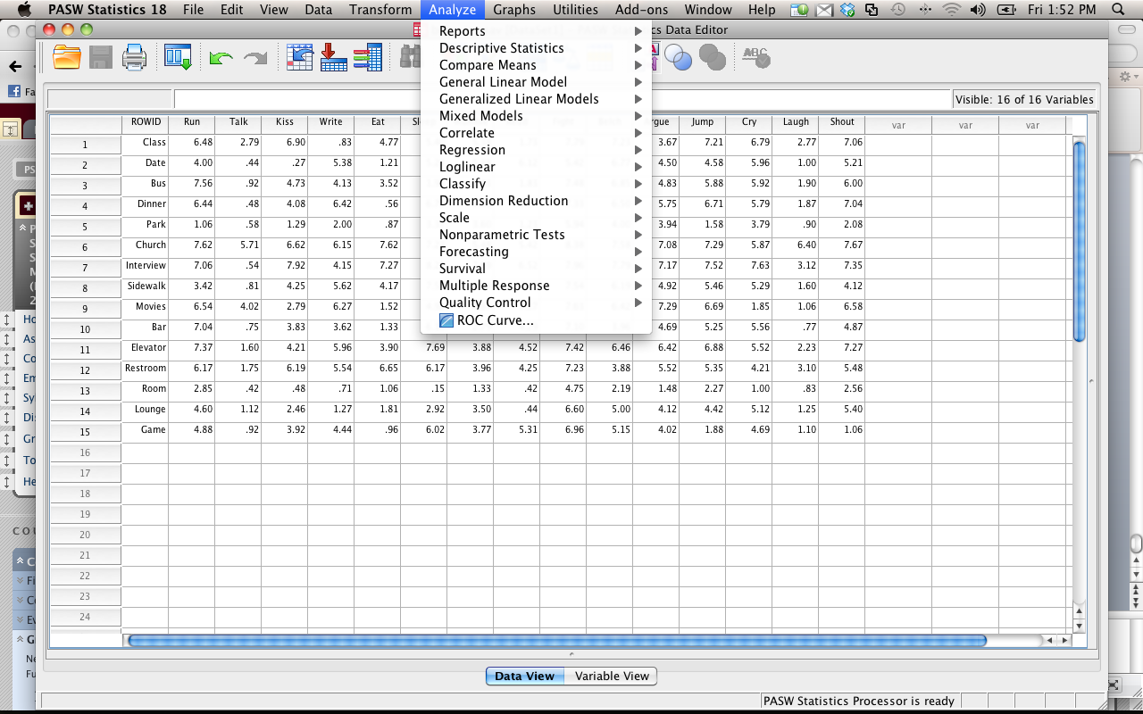

Slide 22
Graphs Window
Let’s you create scatter plots, histograms, line, and bar graphs.
Note: most people (myself included) find excel a little easier to use than SPSS when it comes to graphs.
Either is acceptable.

Slide 23
